Slide 1

VaxSphere: Transforming Vaccine Distribution
by Group 16

Slide 2
The VaxSphere Team
Ethan Gomes
Akshit Verma
Varun Singh

Slide 3

Addressing Inefficiencies in Vaccine Workflows
Streamlined Scheduling
Transparent Ordering
Automated vaccine ordering ensures timely delivery and prevents stock issues.
VaxSphere centralizes appointments, eliminating manual processes and reducing wait times.
Simplified Logistics
Automated Financial Management
Real-time tracking of vaccine shipments ensures transparency and accountability.
Automated billing, payments, and reimbursements promote efficiency and transparency.

Slide 4
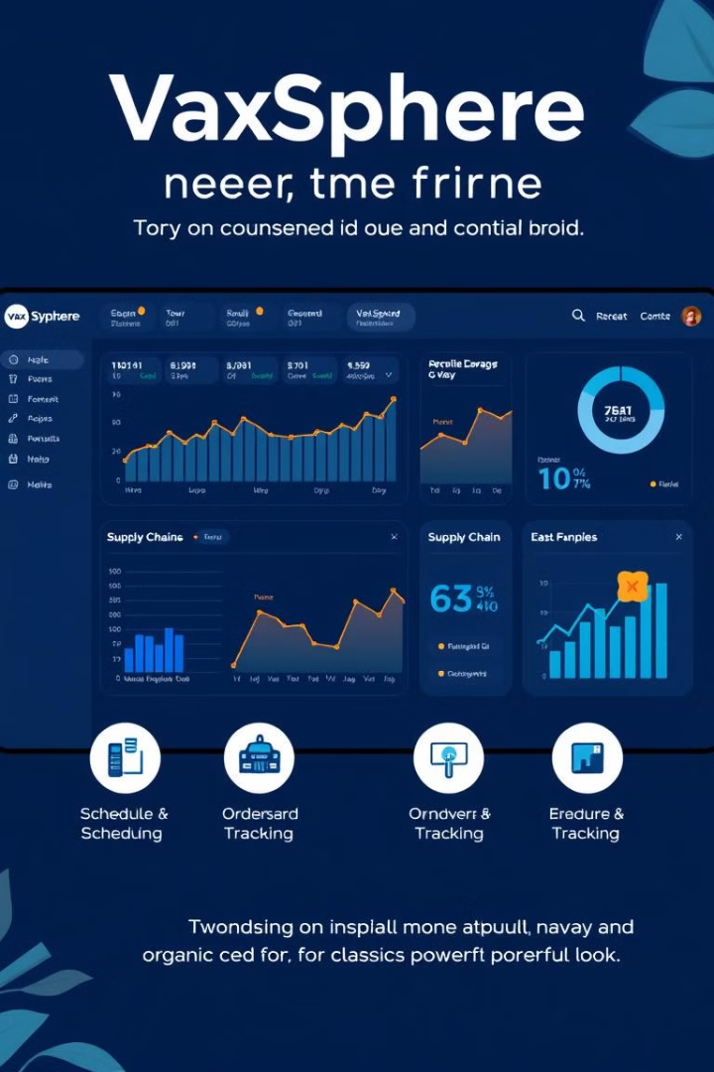
Key Features of VaxSphere
Centralized Scheduling
Automated Ordering
VaxSphere simplifies appointment scheduling for both individuals and healthcare centers, streamlining the process and reducing wait times.
VaxSphere automates vaccine ordering and approval processes, ensuring timely delivery and optimizing inventory management.
Supply Chain Tracking
Safety Monitoring
VaxSphere provides real-time visibility into vaccine shipments, enabling proactive management and ensuring efficient logistics.
VaxSphere empowers proactive safety monitoring, enabling rapid identification and response to potential issues, ensuring the safety of every dose.

Slide 5




Stakeholder Access and Collaboration
Governments
Manufacturers
Centers
Governments gain real-time insights into vaccine distribution, enabling effective policy decisions and resource allocation.
Manufacturers can track vaccine distribution, manage inventory, and optimize production, ensuring efficient supply chains.
Vaccine centers streamline appointment scheduling, manage inventory, and access real-time data, enhancing efficiency and patient experience.

Slide 6



Technical Foundations of VaxSphere
Java Swing
Database
Secure Architecture
VaxSphere's user interface utilizes Java Swing, providing a robust and highly customizable experience for all users.
VaxSphere's foundation is a secure and scalable database, ensuring data integrity and reliability.
Data security and user privacy are prioritized through VaxSphere's robust architecture, employing strong encryption and access controls.

Slide 7
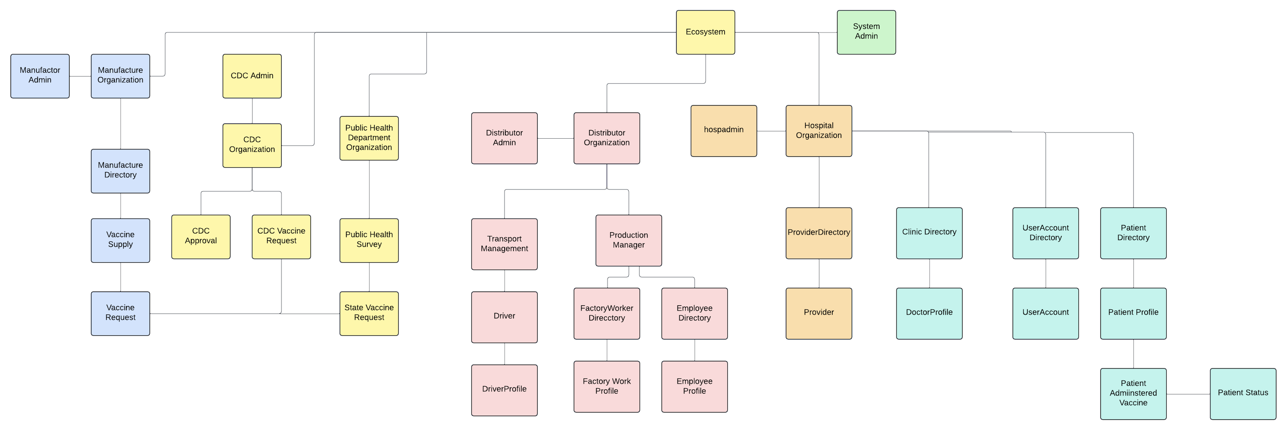
High Level Component Diagram - VaxSphere

